Slide 1
Smart Blind Stick
RajaKumari s (21Bad020)
Bhuvanika S (21bad006)
Suji S (21bad026)

Slide 2
AGENda
Introduction
Objectives
Key Components
System Architecture
Working
Circuit Design
Benefits
Conclusion

Slide 3
introduction
Smart blind stick is basic idea to overcome the difficulty faced by visually impaired individuals in navigating their surroundings. It is done to conquer the limitations of traditional walking canes. A smart blind stick equipped with IoT technology for enhanced navigation and safety

Slide 4
Objectives
Improve mobility and independence for visually impaired individuals.
Enhance obstacle detection and avoidance using IoT sensors.
Provide real-time feedback through auditory or vibration alerts.

Slide 5
Key components
Ultrasonic Sensor: Detects obstacles and measures distance.
Passive Buzzer: Produces various tones and sounds depending on the input signal.
Active Buzzer: Provides auditory alerts.
Arduino Nano: For control and connectivity.
Battery: To provide consistent power for devices
Vibration Motor: Provides vibration feedback when obstacles are detected
Regulator 7805: To provides a steady 5V output from an input voltage

Slide 6
System Architecture
Sensors
Microcontroller
Feedback Mechanism (Buzzer and vibration motor)
Sensors detect environmental changes, send data to the microcontroller, which processes the information and activates the feedback mechanism (e.g., a buzzer, vibration motor) to alert the user.

Slide 7
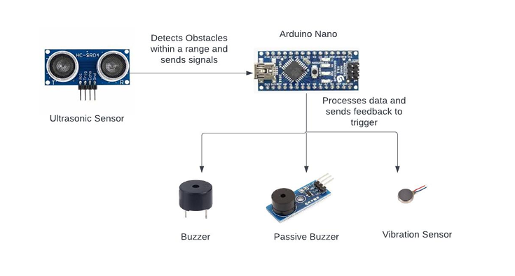
Block diagram

Slide 8
working
Obstacle Detection:
The ultrasonic sensor measures the distance to obstacles and triggers an alert if an object is within a certain range.
Alert System:
The user is alerted via a buzzer and triggered with vibration motor when an obstacle is nearby

Slide 9
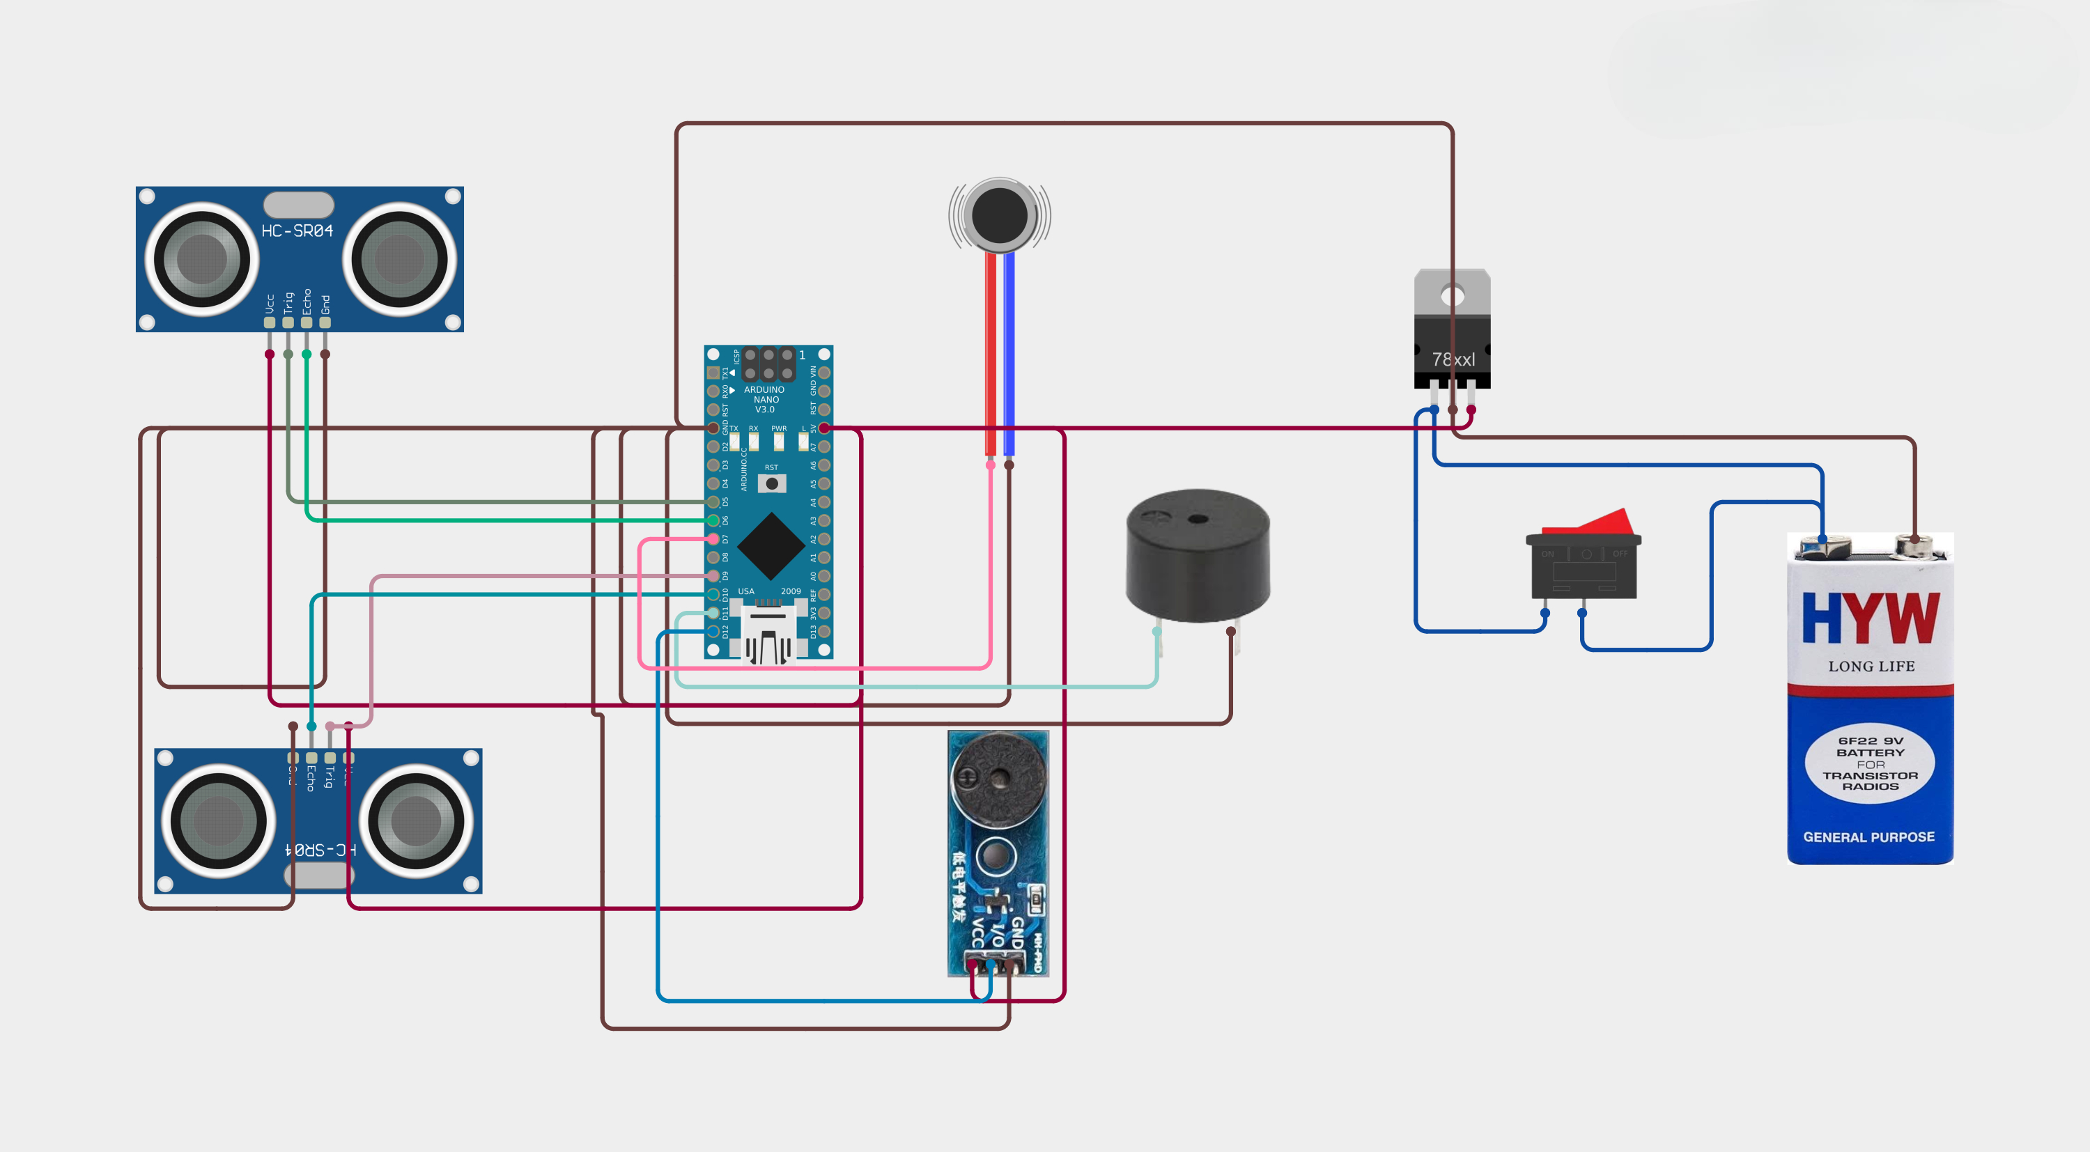
Circuit Design

Slide 10
Benefits
Increased independence for visually impaired users.
Enhanced safety with real-time obstacle detection and fall alerts.
Cost-effective and user-friendly design.

Slide 11
Conclusion
The project has successfully demonstrated a practical and innovative solution to enhance the mobility and independence of visually impaired individuals
Future work may involve refining the design for portability, enhancing the battery life, and incorporating additional features such as emergency alert systems and integration with mobile applications for user-friendly interactions.

Slide 12
Thank you

